Slide 1
Welcoming Your Child – A Parent’s Guide
October 2020

Slide 2
A Parent’s Guide for New Additions
Welcoming a new child into the family is exciting!
LG Health knows how important it is for you to prepare for your child’s arrival – whether welcoming a new baby or an adopted or foster child into your family. In this guide you will find resources and information on your time off benefits and the valuable resources LG Health makes available to new parents.
Time Away
Available Leaves & Benefits
Countdown to Arrival
Planning for arrival
While You Are Away
Returning to Work
Other Resources for Parents
Pregnancy Care
Childcare Services
Articles, Guidebooks, & More
Special Delivery Program
Able Pay
Care@Work

Slide 3
Available Leaves and Benefits
Parental Leave
LG Health offers the following Leave of Absence benefits to parents:
Family and Medical Leave Act (FMLA) | A 12 week job protected leave Birth Mother – 12 weeks includes both medical recovery and bonding with your newborn Non-Birth Parent – 12 weeks of bonding (can be taken anytime in first year of babies life)
NON-FMLA | An employment protected leave Birth Mother – a medical recovery leave (typically 6 – 8 weeks + 30 days of bonding (12 weeks maximum) Non-Birth Parent – 30 days of bonding (can be taken anytime in first year of babies life)

Slide 4
How Will I Be Paid During My Leave of Absence? EXAMPLES
Continuous FMLA LOA – Birth Mother
Birth Mother | 1st 7 Consecutive Calendar Days | 8th Consecutive Calendar Day through Entire Medical Leave | After Medical Release – Additional 20 Consecutive Calendar Days of Bonding | End of STD Bonding Period through End of LOA
 | PTB Scheduled Medical Self/Family NO PAY (PTB Exhausted) | Short Term Disability (STD) PTB Scheduled Medical Self/Family (STD Exhausted) NO PAY (PTB & STD Exhausted) | Short Term Disability PTB Scheduled Medical Self/Family (STD Exhausted) NO PAY (PTB & STD Exhausted) | PTB Scheduled Medical Self/Family NO PAY (PTB Exhausted)
Continuous FMLA LOA - Birth Spouse, Foster or Adoptive Parent
Birth Spouse, Foster or Adoptive Parent | 1st 7 Consecutive Calendar Days | 8th Consecutive Calendar day of LOA through 27th Consecutive Calendar Day | Remainder of Leave
 | PTB Scheduled Medical Self/Family NO PAY (PTB Exhausted) | Short Term Disability (STD) PTB Scheduled Medical Self/Family (STD Exhausted) NO PAY (PTB & STD Exhausted) | PTB Scheduled Medical Self/Family NO PAY (PTB Exhausted)

Slide 5
Preparing for Your New Arrival
4 – 6 months prior
See your physician
Prenatal health care is very important to both mother and child
Sign up for Special Delivery Program
Trustmark** provides support during/after pregnancy at no additional cost.
Contact Trustmark for more information at 888-785-2229; or
Visit their website at Trustmark Special-Delivery
Contact your Health Insurance Provider
Review Time Off and Leave of Absence policies
Information can be found in Policy Center on Starnet
Enter a Leave Request in Workday and recommend you make your manager aware of your leave
Enroll in Care.com for support in planning for baby
Sign up for AblePay to help with out of pocket expenses.
Contact AblePay for more information 484-292-4000
Visit their website at www.ablepayhealth.com
**NOT APPLICABLE TO HORIZON HEALTHCARE SERVICE EMPLOYEES

Slide 6
Preparing for Your New Arrival
When Your Child Arrives
Be sure to….
Communicate the start date of your leave to your manager
Enroll your child in LG Health’s benefits
Be sure to enroll your child in applicable benefits within 30 calendar days of the birth through Workday (See Page 10 for instructions)
Health, Dental and/or Vision Coverage
Flexible Spending Accounts (FSA)
Health Saving Account
Get a Social Security Number (SSN) for your child
A SSN allows you to capture tax benefits that will help defray some child care costs

Slide 7
Consider using an Eliance Health Network Provider…. Woman and Babies Hospital A Baby-Friendly hospital offering an optimal level of care for infant feeding and mother/baby bonding
Maternity services that allow a personalized approach to your care, understanding your preferences and concerns while offering support and education at every step.
Practices to Meet the Goals for your Newborns Feeding Needs
Understanding the Importance of Rooming In
Supportive Breastfeeding Center
Enhancing the bonding experience with early Skin to Skin contact
Free Baby Weigh Station
Offering Outpatient Feeding Assistance with an Individualized Feeding Plan

Slide 8
Women & Babies Hospital Classes for New & Expecting Families
Classes fill up quickly! Call 717-544-3300 for registration and insurance coverage information
See attached Brochure for Details on all Classes
A helpful guide to help you determine which classes you should take and when to take them.
28 – 36 Weeks
Approaches to Un-Medicated Birth
Baby Care Basics
Breastfeeding
Childbirth Preparation
Anytime before baby
Father’s Boot Camp
Grand parenting in the 21st Century
Pregnancy Yoga
Sibling Class
Twins & More
Infant CPR
Anytime before baby/after baby is born
Breastfeeding and Returning to Work
Night Night Newborn (up until baby is 8 weeks old)

Slide 9
Your Benefit Considerations
Consider making the following changes:
Your premium payments while you are on leave:
If while on leave status any portion of your premium is unpaid resulting in no premium deduction(s) for Medical, Dental, and/or Vision Insurance, these premiums will be deducted over several pays upon your return to work
Increase Life Insurance (subject to Evidence of Insurability)
Elect Dependent Life insurance
Update your employer provided Retirement Plan & Life Insurance beneficiaries
Add new addition to medical, dental, and/or vision coverage
Elect/Increase Dependent Care Flexible Spending (for children under 13) for daycare expenses
Need more information? Check out In The Know: What Happens to my benefits when I go on leave?

Slide 10
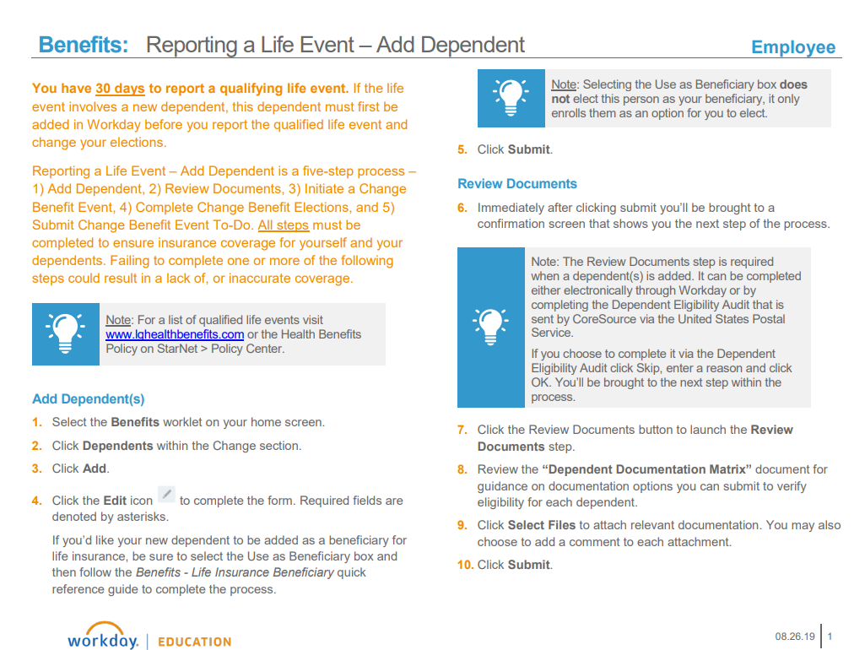
Enroll Your Child in Benefits
Employees must complete both “Add a Dependent” and Report a “Life Event/ Coverage Change Event” in Workday within 30 days of the child’s birth or adoption

Slide 11
In The Know
What happens to my benefits when I go on a Leave of Absence?
HOW ARE BENEFIT DEDUCTIONS PAID WHILE ON LEAVE?
If while on leave status any portion of your leave is unpaid resulting in no premium deduction(s) for Medical, Dental and/or Vision insurance, these premiums will be payroll deducted over several pays upon your return to work.
Upon being placed on leave of absence status, your voluntary premium for any Voluntary Benefit(s) will be handled as follows:
Securian (Minnesota Life) – Voluntary Life: If a premium payment is missed via payroll deduction, Securian will issue an invoice directly to you. You will be responsible for paying that premium directly to Securian while out on leave.
Farmington – Voluntary Short Term Disability: If a premium payment is missed via payroll deduction, Farmington will initiate billing based on the missed deduction and send you a missed deduction letter to your home address.
Health Savings Accounts – These deductions will stop when you enter an unpaid status. You can make arrangements directly with Health Equity to continue the deductions or restart them when you return from leave.
LGHealthBenefitExtras (Corestream) - If 3 premium payments are missed via payroll deduction, Corestream will alert the respective vendor and they will issue an invoice directly to you. You will be responsible for paying that premium while out on leave. Should you miss less than 3 deductions, your premiums will be recalculated upon return to make up for the missed deductions.
AM I ABLE TO CONTINUE USING MY FLEXIBLE SPENDING ACCOUNT(S)?
Employees participating in the Health Care Flexible Spending Account (FSA) will be able to utilize this account while on a Leave of Absence. However, after 5 weeks of leave the benefit will be discontinued. If you would like to continue this benefit, you will need to make payments to Trustmark (877-848-9997) directly. To set up payments, please contact our benefits team: LGH-Benefits@pennmedicine.upenn.edu. Direct billing is through the Trustmark COBRA department. They will send you monthly payment coupons. These payments must be made in 60 days to keep the coverage active. If you do not wish to continue FSA payments during your leave, you may re-elect the benefit upon your return.
Employees participating in the Dependent Care Flexible Spending Account (FSA) will not be able to participate in this account while on a Leave of Absence. IRS guidelines require that both parents are working in order to use this benefit. We will discontinue this coverage on your behalf. You may re-enroll in this benefit upon your return from Leave of Absence.
I HAVE A RETIREMENT LOAN, HOW CAN I MAKE PAYMENTS?
Employees with retirement loans should contact Fidelity Retirement at 1-800-343-0860, to ensure loan payments remain current during any period of unpaid Leave of Absence.

Slide 12
I have Lancaster General Health Insurance…..
What Benefit Coverages are available when enrolled in LG Health Medical Programs:
Covered expenses shall include charges for Lancaster General Health approved group health education courses for the following programs:
Pre & Post Natal Education
Childbirth class: 80% attendance – reimbursement $70
Baby Care Basics: 80% attendance – reimbursement $25
Father’s Boot Camp: reimbursement $25
Breastfeeding Class: 80% attendance – reimbursement $25
Breastfeeding and Returning to Work Class: 80% attendance – reimbursement $15

Slide 13
After Your Child Arrives
During your bonding period
Update or create a will to ensure your new addition is protected
Information is available through Quest EAP Legal and Financial Services
Call 1-888-254-8104 and use employer code: QEAP-LGH; or
Via their website, navigate to www.worklife-benefits.com and enter User Name: qeap and Password: lfs (legal financial services)
Start childcare plans early
LG Health offers subsidies to employees who enroll in Chesterbrook Academy @ College Hill
Stock up on supplies (if using a childcare provider)
Make a checklist of all the things your child needs; buy things like breast milk bags, nursing pads, and diapers in bulk
Check out local and nationwide discounts through LG Health Benefit Extras.
Visit their website: www.lghealthbenefitextras.com to explore discounts

Slide 14
Returning to Work After Your Child Arrives
Easing the transition back to work
If nursing, know where to go
(birth parent)
Contact your Manager to find out about Lactation Room availability
Care.com
Quest EAP
Advise your Manager of your return to work date at least 2 full business days prior to your date of return

Slide 15
Nursing Mothers Information & Lactation Room Location
Lancaster General Health is committed to maintain a family friendly workplace and supporting the health and well-being of our employees. Nursing mothers with be provided with support, space, and time for managing lactation responsibilities at work. Employees are encouraged to meet with their manager to establish a flexible work schedule that allows for sufficient break times.
Private Lactation rooms are equipped with a chair, table, electrical outlets, light, doors labeled indicating room in use, trashcan, paper towels and sanitizer. A hospital grade pump is available for use. Mothers are responsible for providing personal storage of the breast milk.
Duke Street Locations:
Employee Service Center
Employee Health
Outside Physical Medicine & Rehab Department
Suburban Outpatient Pavilion – 2108 Building– 3rd Floor
Norlanco Outpatient Center – located in Ultrasound/Mammography Hallway
BURLE – Kitchen area located near conference rooms/outside of LGHP Administration area
Women & Babies Hospital – located in Couplet Care Unit

Slide 16
Important Contact Information
Your resource center….
Program | Contact
LG Health Policies | Visit Policy Center on Starnet
Leaves of Absence | Carol McCall Leave Administrator Carol.McCall@pennmedicine.upenn.edu 1-717-544-4105
Health Insurance and Special Delivery Program | Trustmark www.mytrustmarkbenefits.com 1-877-848-9997 (Insurance Benefits) 1-888-785-2229 (Special Delivery)
Chesterbrook Academy at College Hill | Chesterbrook Academy 1-877-959-4183 (M-F 6a-6p)
Child and Family Care Benefits | Care.com Membership Lghealth.care.com Your dependent must be in Workday and under 13 years of age.
Convenience Pharmacy at Lancaster General Hospital | 555 N Duke St. Lancaster, PA 17602 Hours: 7am-6pm (M-F) 9am-3pm (Sat) Closed Sunday & Holidays 1-717-544-5929
Convenience Pharmacy at Suburban Outpatient Pavilion | 2100 Harrisburg Pike, Lancaster, PA 17601 Hours: 8:30am-5pm (M-F) Closed Saturday, Sunday & Holidays 1-717-544-3154
Convenience Pharmacy at Kissel Hill | 51 Peters Rd, Lititz, PA 17543 Hours: 8am-5:30pm (M-F) Closed Saturday, Sunday & Holidays 717-627-7689

Slide 17
Additional Resources
Program | Contact
Supplemental Nutrition Assistance Program (SNAP) | 1-800-221-5689
Special Supplemental Nutrition Program for Women, Infants and Children (WIC) | 1-800-221-5689 Fact Sheet: https://fns-prod.azureedge.net/sites/default/files/wic/wic-fact-sheet.pdf
Child Care Information Services (CCIS) | 1-717-393-4004
Quest EAP | Quest EAP 1-800-364-6352
United Way | 1910 Harrington Drive, Suite A, Lancaster PA 17601 1-717-394-0731
Healthy Beginnings Plus for pregnant women who are income eligible | 1-717-544-4305
Nurse Family Partnership for employees parenting for 1st baby & who are income eligible (must enter before 28 weeks of pregnancy) | 1-717-544-1952
LaLeche League provides support, encouragement and education for a better understanding of breast feeding | 1-800-525-3243 (administration office)

