Slide 1
Understanding Your Prescription Plan Coverage
LIVE YOUR LEGACY
Notes:
Your Penn Medicine Lancaster General Health Insurance Plans have prescription drug coverage built in. Let’s review the coverage and how your choices can help you find the best pricing and service. After all, your medications play a vital role in helping you manage your health.

Slide 2
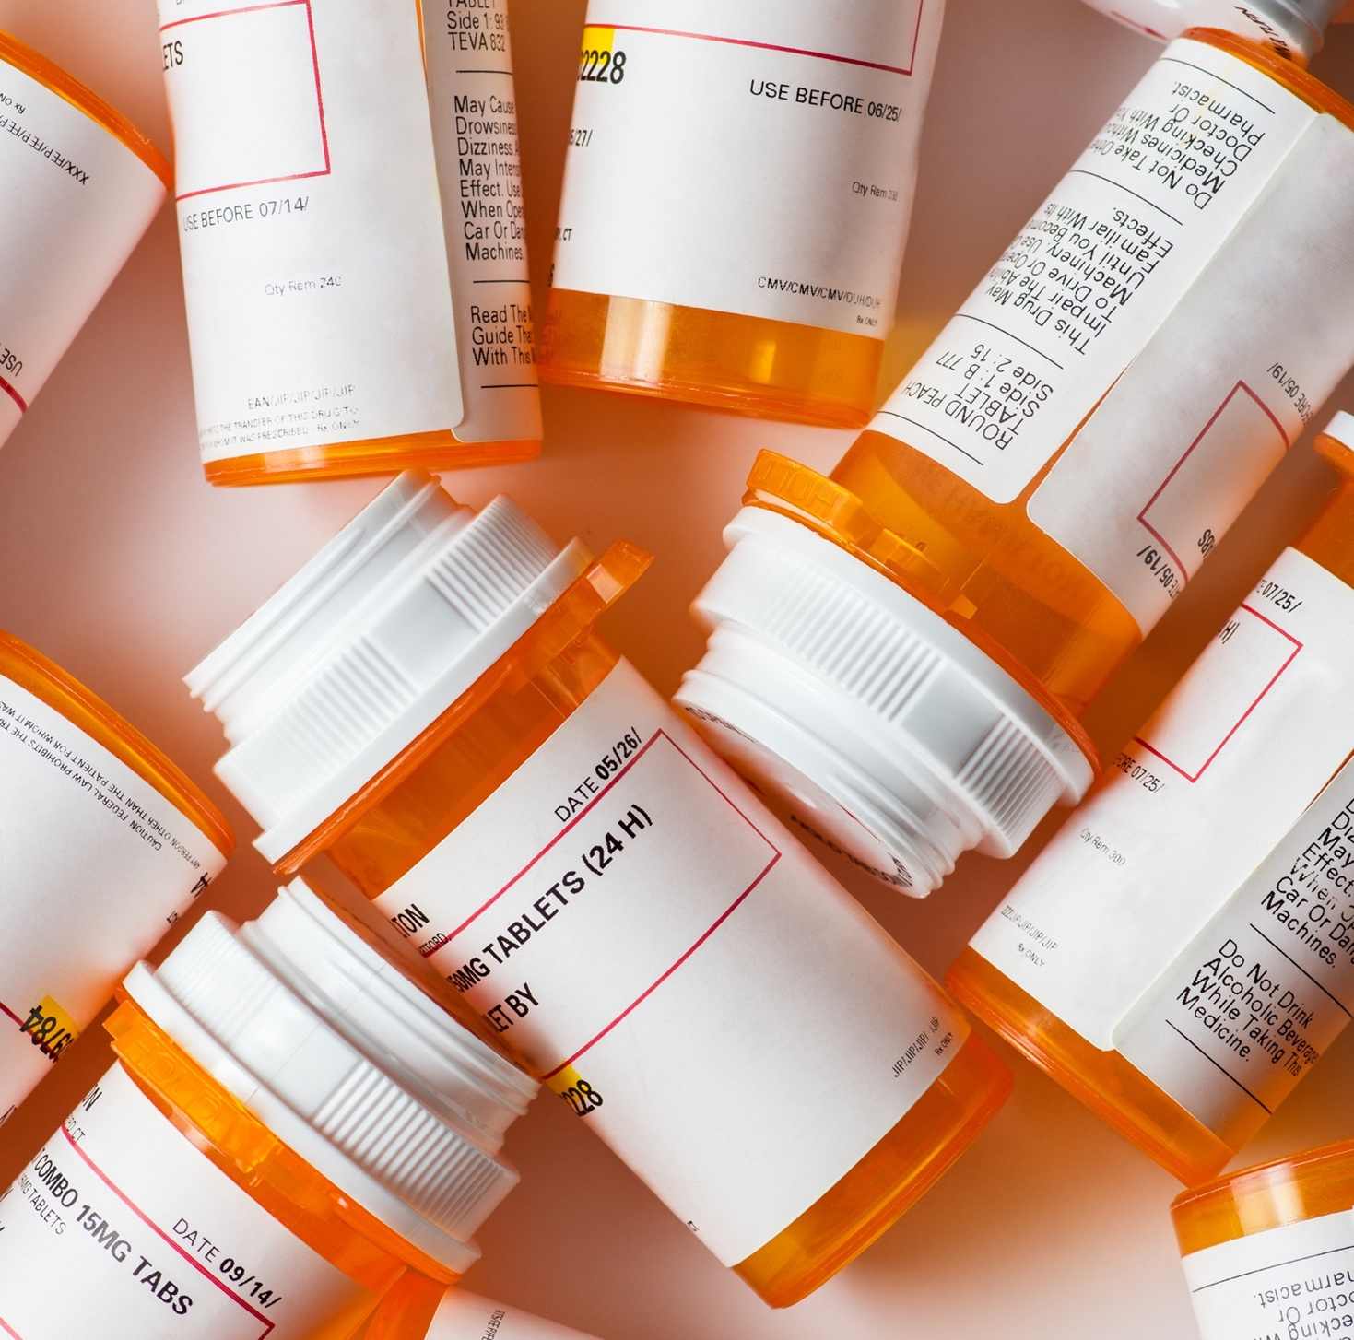
Prescription Drug Coverage
$0 copay or deductible
Generic contraceptives
Preventive medicines (cholesterol, BP, etc.)
OTC preventives with a prescription
Specialty medications (after deductible for Consumer Plan)
Includes prescription ID card
Notes:
The LG Consumer and LG Select health plans include comprehensive prescription benefits with great pricing and service from our onsite Convenience Pharmacies, plus coverage at retail pharmacies in the Liviniti network. You receive a prescription ID card when you enroll in the health plan.
For both health plans, you pay no copay or deductible for generic contraceptives and preventive prescriptions for things like high cholesterol and blood pressure – even prescribed over-the-counter items. Many specialty medications also are free, depending on the plan you choose.

Slide 3
Convenience Pharmacies — Lower Cost
next day
$$
Select Plan: Pay the lesser of the prescription cost or copay
Consumer Plan: Pay full cost to deductible
Both Plans:
15% discount on over-the-counter meds
Employee-only discounted products
Most non-stocked items available the next day
Notes:
Our onsite Convenience Pharmacies offer exceptional pricing and services. If you aren’t aware or already using them, please listen closely, so you don’t miss out.
First, let’s look at the lower prices. No matter which health plan you choose, preventive generic prescriptions for hyperlipidemia and hypertension, for example, are available at no cost. For other medications, with the Select Plan, you pay the cost of the prescription or the insurance copay, whichever is less. For the Consumer Plan, you pay the full cost until you reach the deductible.
You also receive a 15% discount on over-the-counter products.
And, many “Employee Only” discounted products are available behind the counter. You can find the list on StarNet.
The onsite pharmacies can order just about anything you need and have it available the next day, as well.

Slide 4
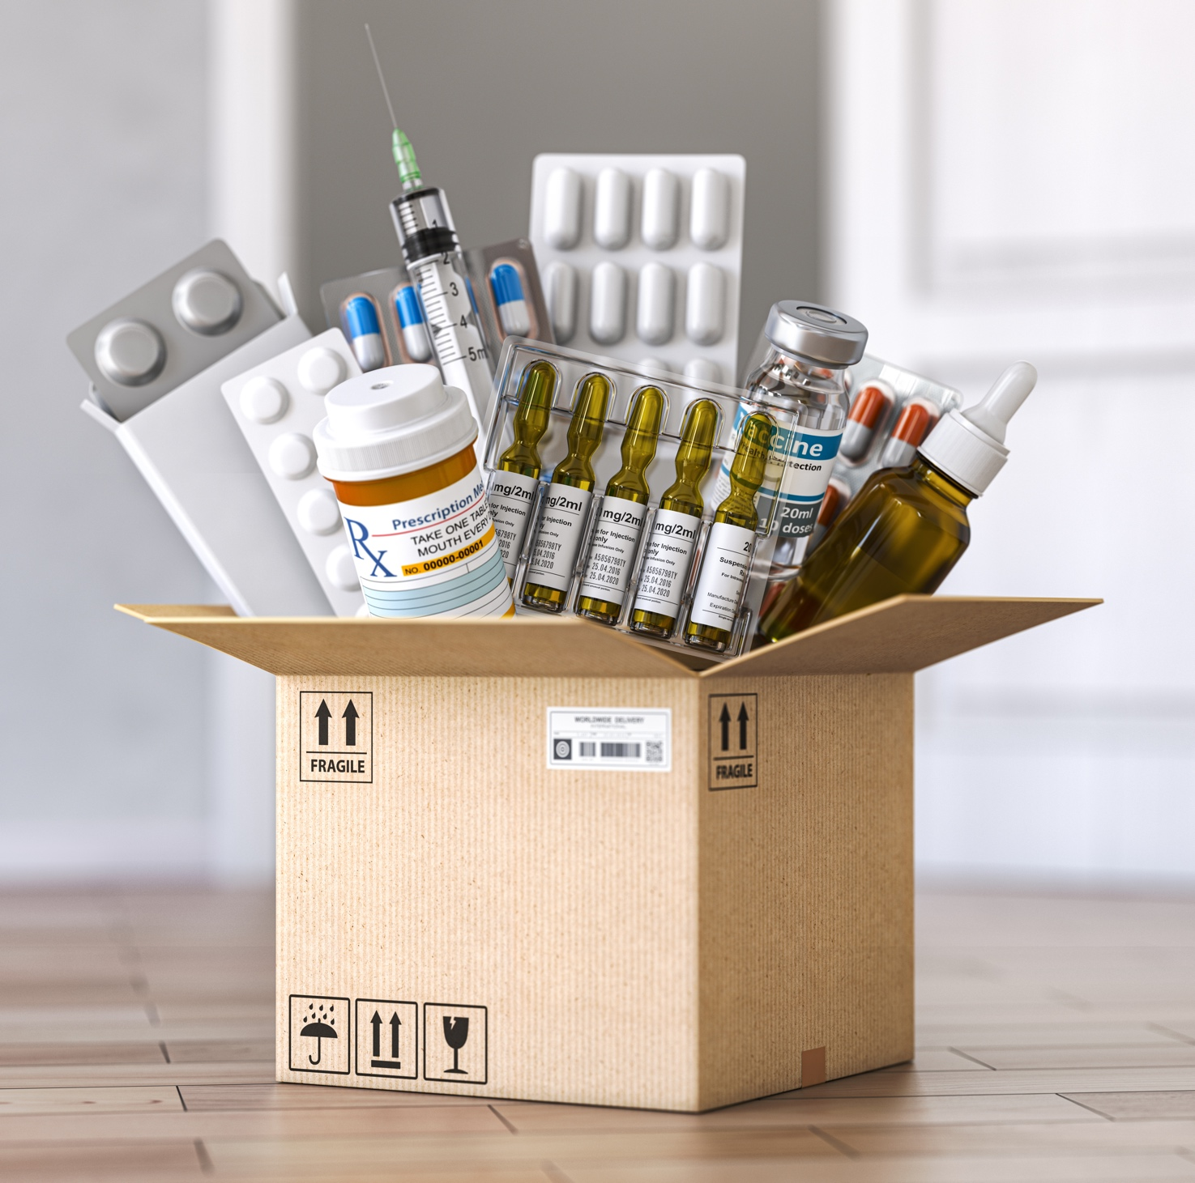
Convenience Pharmacies — Delivery
Free deskside delivery
Free home delivery of 90-day supply of maintenance medications or 30-day supply of specialty medications
Refrigerated and non-refrigerated medications
For you, your dependents and pets
Notes:
You can have the Convenience Pharmacy deliver your prescriptions to your work location or deskside – at the Heart Group or Willow Street, for example -- without a delivery fee.
They will even deliver a 90-day supply of maintenance medications or a 30-day supply of specialty medications to your home for free via FedEx or the local LGH delivery service.
This includes refrigerated and non-refrigerated medications for you and your dependents and pets.

Slide 5
Convenience Pharmacies — Specialty Drugs
Specialty drugs covered through Convenience Pharmacy only
Some offered for free (after deductible for Consumer Plan)
Pharmacy handles copay assistance cards, financial assistance and prior authorizations – LGH/Penn Medicine practices
Notes:
The Convenience Pharmacies are the only source for specialty drugs under the LG Health Insurance Plans, and medications on the approved list have no copay – even some of the newer drugs for treating diabetes and other autoimmune diseases! The pharmacy handles copay assistance cards, financial assistance and all prior authorizations for employees and patients seen by LGH/Penn Medicine Practices. This is an extraordinary, superior benefit – rarely available from other employer benefit plans.

Slide 6
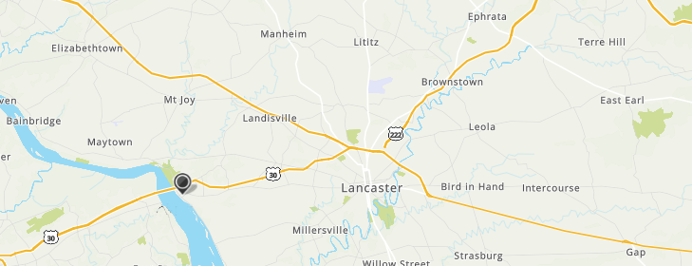
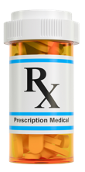
Convenience Pharmacies — Locations
Kissel Hill
Suburban Outpatient Pavilion, Third Floor
Lancaster General Hospital, First Floor
Columbia Outpatient Center, First Floor
Open weekdays; see hours
+ LG Hospital is open Sat. 9-3
Notes:
In addition to requesting delivery services, you can visit the onsite pharmacies at these locations. They’re all open weekdays, and hours vary. The hospital location also is open Saturdays from 9 a.m. to 3 p.m. Check lghcp@pennmedicine.upenn.edu for specifics.

Slide 7
Select Plan Copays
30-day supply
 | Convenience | Retail
Generic | $5 | $15
Brand preferred | $15 | $45
Brand non-preferred | $30 | $75
Specialty | $0 | NA
Notes:
Each health plan has a prescription copayment schedule. Under the Select Plan, you pay these copayments for each 30-day prescription, with no deductible. 90-day supplies are available for two times the 30-day price, whether from the Convenience Pharmacy or by mail order.

Slide 8
Consumer Plan Copays (after deductible)
30-day supply
 | Convenience | Retail
Generic | $5 | $10
Brand preferred | $15 | $30
Brand non-preferred | $30 | $60
Specialty | $0 | NA
Notes:
For the Consumer Plan, you pay the cost of non-preventive prescriptions and medical care until you meet the deductible. Even then, your prices at the Convenience Pharmacy often will be lower than retail prices.
Once you meet the deductible, you’ll pay these copayments for each 30-day prescription. 90-day supplies are available for two times the 30-day price from the Convenience Pharmacy or by mail order.

Slide 9
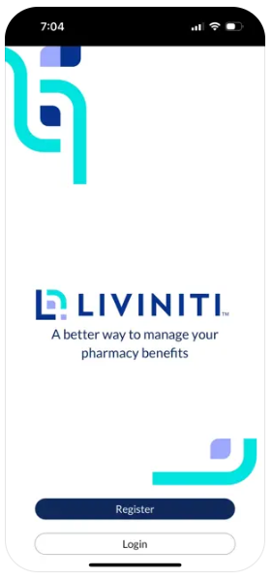
Retail Options: Liviniti Network
liviniti.com/members
Look up drug prices
Get a digital ID card
Check prior authorization status
And more
Notes:
If you aren’t able to use the Convenience Pharmacy, don’t worry. You can purchase prescriptions from retail locations in the Liviniti network – formerly Southern Scripts.
Liviniti offers a convenient portal and app to help you find a network pharmacy, look up drug prices, get a digital ID card, check prior authorization status and more.

Slide 10
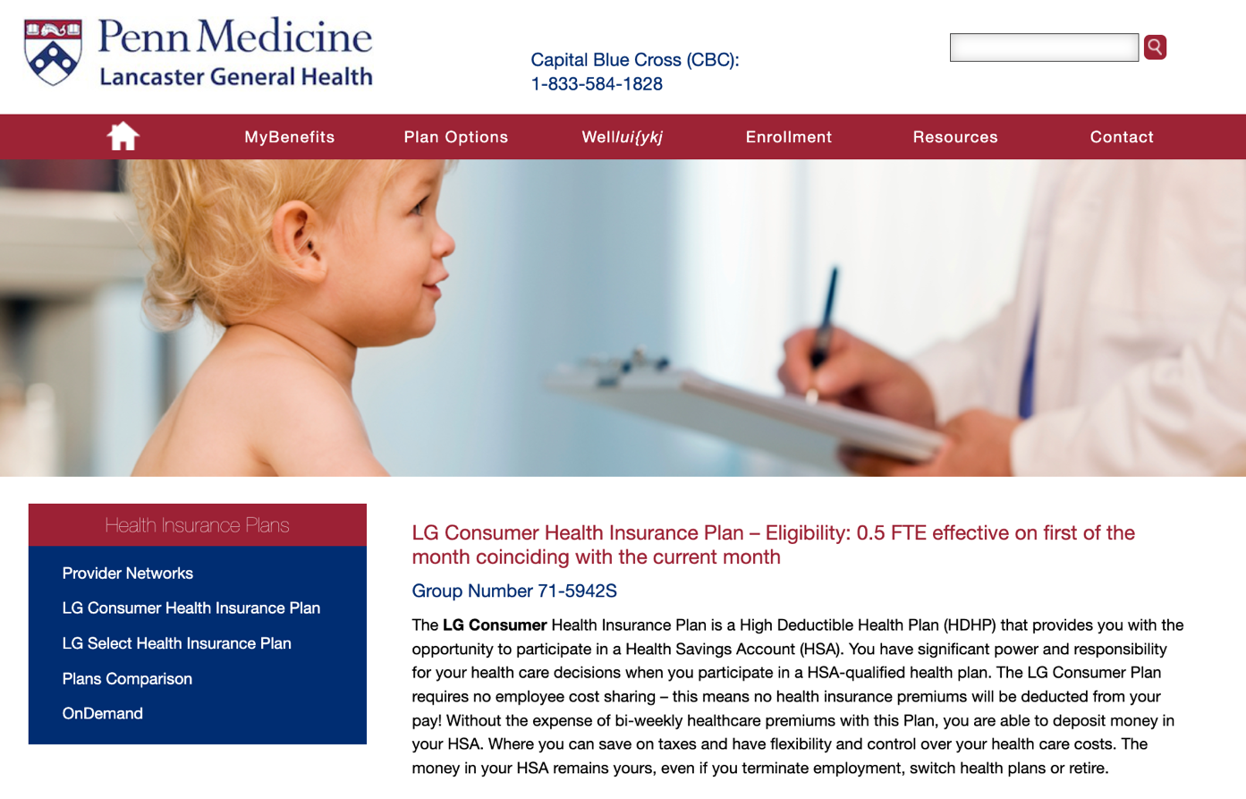
Learn More
lghealthbenefits.com
LGH-benefits@pennmedicine.upenn.edu
Questions? Call 717-544-4915
Copies of the plan documents are always available at lghealthbenefits.com.
Notes:
You’ll find all the details about how your prescription coverage works, including plan documents, at lghealthbenefits.com. You can also email or call the LGH benefits team for help.
Take advantage of ways to save on your medications – so you can manage your health just as your care provider ordered!

